Slide 1

ST.JOSEPH
COLLEGE OF ENGINEERING
RECIPE GENERATOR
FROM FOOD IMAGE USING AI
GUIDED BY
Mrs. M.R.SUREKHA M.E
Assistant professor,
Dept of Information Technology
PRESENTED BY
BALAJI .B (212920205005)
ELAVARASAN . E (21292020205011)
KARTHICK . S (212920205025 )

Slide 2
ABSTRACT:
The Food Recipe Generator from Food Image project introduces an innovative AI-driven approach to culinary exploration.
By leveraging cutting-edge image recognition and natural language processing techniques, the system automatically identifies ingredients and dishes from food images and generates detailed recipes accordingly.
Through a user-friendly interface, users can upload images and receive instant recipe suggestions, project represents a convergence of computer vision, machine learning, and culinary arts, offering a glimpse into the future of AI-powered food-related applications.

Slide 3
EXISTING SYSTEM:
Existing systems for generating recipes from food images utilize image recognition and machine learning algorithms to identify ingredients and dishes, often employing pre-trained convolutional neural networks (CNNs) to classify food items.
However, these systems may encounter challenges in accurately recognizing complex dishes and providing detailed cooking instructions. Despite these limitations, they represent a significant advancement in AI-driven culinary exploration, with ongoing research aiming to improve accuracy and personalization capabilities for enhanced user experiences.

Slide 4
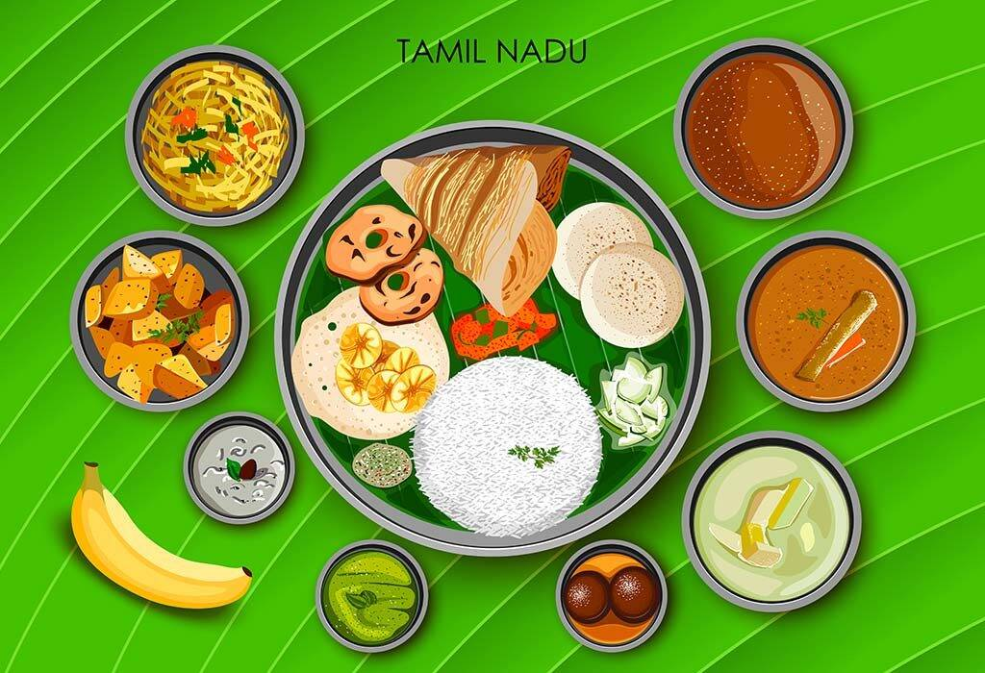
DISADVANTAGES:
Inaccurate Identification
Lack Of Personalization
Static Datasets
Reduced Relevance
Limited Cooking Instructions

Slide 5
INTRODUCTION:
The integration of artificial intelligence (AI) into culinary exploration has led to the development of systems capable of generating recipes from food images. By leveraging image recognition and machine learning algorithms, these systems automatically identify ingredients and dishes depicted in images and provide corresponding recipes.
While these systems represent an exciting advancement in culinary technology, they also face challenges and limitations. This paper explores the existing systems for recipe generation from food images, discussing their strengths, weaknesses, and opportunities for improvement. Through this analysis, we aim to contribute to the ongoing evolution of AI-driven culinary exploration.

Slide 6
PREPARING THE DATASET:
Preparing the dataset for recipe generation from food images involves collecting a diverse set of food images from various sources and annotating them with labels indicating ingredients and dishes.
After preprocessing and augmenting the data, it is split into training, validation, and test sets. Data cleaning ensures the removal of irrelevant or low-quality images, while class balancing ensures equal representation.
Optionally, metadata like recipe text and nutritional information can be integrated. This well-prepared dataset forms the basis for training and evaluating image recognition and recipe generation models, facilitating accurate and robust system development.

Slide 7
PROPOSED SYSTEM:
The proposed system for generating recipes from food images utilizes advanced image recognition and natural language processing technologies. It automatically identifies ingredients and dishes in uploaded images and generates corresponding recipes with detailed cooking instructions.
Users can interact with the system through a user-friendly interface, which also offers personalized recommendations based on their preferences and dietary restrictions. By integrating these components, the system aims to provide a seamless and enjoyable experience for users looking to explore new dishes and improve their cooking skills with ease.

Slide 8
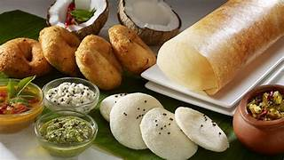
ADVANTAGES:
Automated recipe generation
Efficiency
Accessibility
Personalization
Learning and improvement
Diverse recipe selection

Slide 9
LITERATURE REVIEW:
Title: "From Pixels to Recipes: Recipe Generation Using Deep Visual Representations of Food Images"
Authors: Marc A. Zimmerman, Amaia Salvador, and Ferran Marques
Journal/Conference: arXiv preprint arXiv:1812.06164 (2018)
Summary: This paper explores the use of deep learning techniques to generate recipes from food images. It proposes a model that leverages convolutional neural networks (CNNs) to extract visual features from food images and generates corresponding recipes using a recurrent neural network (RNN) architecture.

Slide 10
SYSTEM STUDY
The aim of the proposed system is to automatically generate recipes from food images, streamlining the cooking process for users. This involves accurately identifying ingredients and dishes, generating coherent and personalized recipes, and presenting them through a user-friendly interface.
The system strives to enhance culinary exploration and skill development while providing a seamless and intuitive experience for users. Ultimately, it aims to revolutionize how individuals discover, create, and enjoy meals in their daily lives.

Slide 11
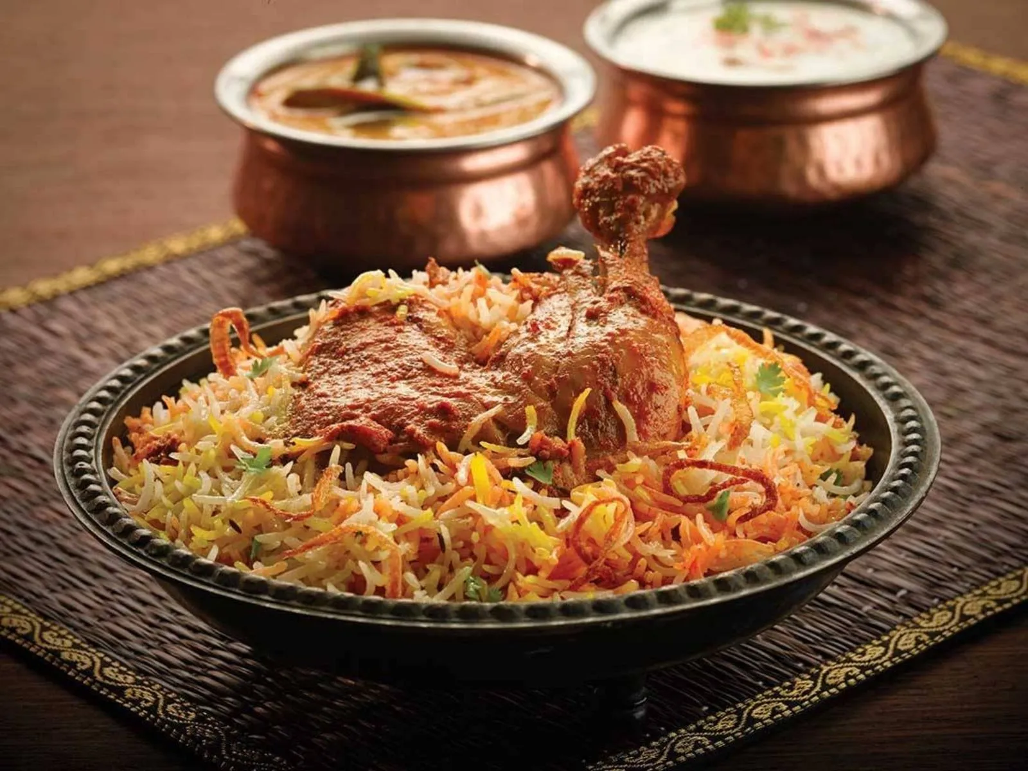
LIST OF MODULES:
Image Recognition Module
Recipe Generation Module
User Interface Module
Personalization and Recommendation Module
Data Pre-processing Module
Model Training and Evaluation Module
Integration Module
Feedback and Iteration Module
Database Management Module
Deployment and Maintenance Module

Slide 12
ENVIRONMENTAL REQUIREMENTS:
1. Software Requirements:
Operating System : Windows, macOS, and Linux distributions
Tool :Python, TensorFlow, PyTorch, Flask (for web development), and appropriate deep learning frameworks and libraries.
2. Hardware requirements:
Processor : Intel i3 or AMD Ryzen 5
Hard disk : minimum 10 GB
RAM : minimum 4 GB

Slide 13
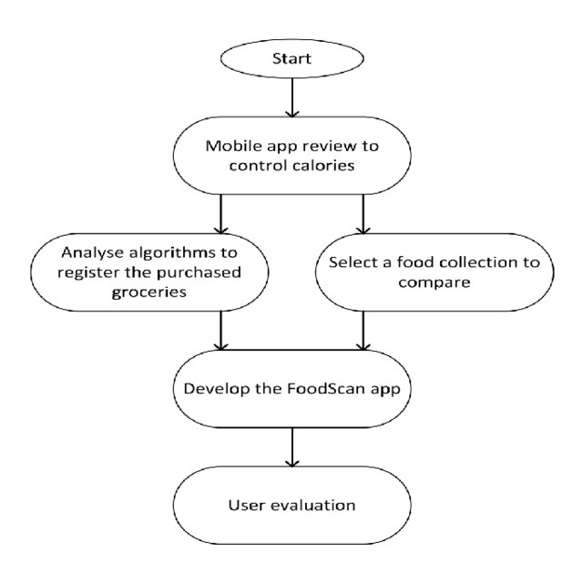
SYSTEM ARCHITECTURE:

Slide 14
CONCLUSION:
In conclusion, the proposed system for recipe generation from food images represents a promising fusion of computer vision, natural language processing, and machine learning technologies.
By automating the process of identifying ingredients and dishes from images and generating corresponding recipes, the system aims to streamline the cooking process for users and enhance their culinary exploration experiences. Through a user-friendly interface, personalized recommendations, and continuous learning mechanisms, the system empowers users to discover new dishes, improve their cooking skills, and make informed culinary decisions.

Slide 15
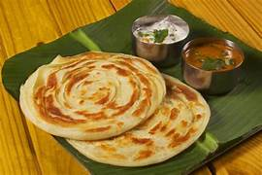
FUTURE WORK:
Enhanced Image Recognition
Advanced Recipe Generator
Personalization And Adaptation
Multimodal Integration
User Engagement And Interaction
Integration With IOT Devices

